Slide 1
TexGen Workshop
Louise Brown

Slide 2
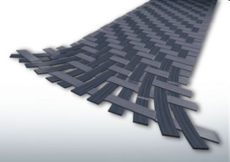
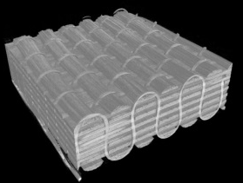
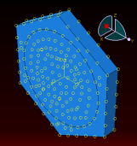
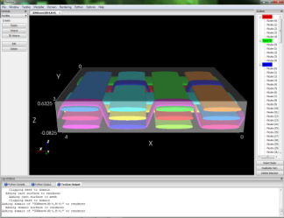
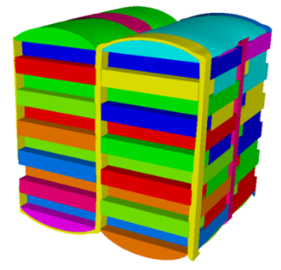
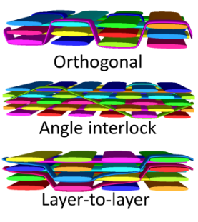
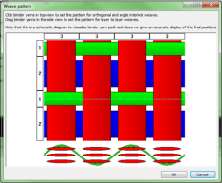

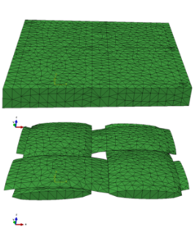
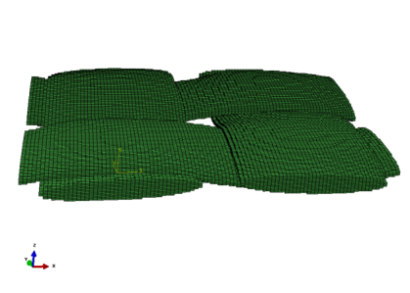
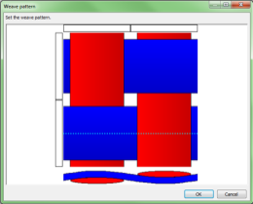
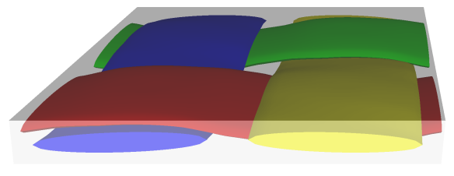
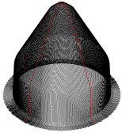

TexGen Geometric Textile Modelling Software
Fibre/Micro-Scale
Micro-scale FEA simulations or analytical methods determine yarn properties
Unit Cell/Meso-Scale
Generate textile geometry using TexGen GUI or script
3D wizard generates idealised 3D textiles
Refinement of orthogonal weave to simulate compaction
Automatically generate 2D and 2D sheared textiles
Generate mesh and input files for FEA or CFD to predict material properties
Composite material properties extracted from meso-scale predictions are used to model structural components
Component/Macro-Scale

Slide 3
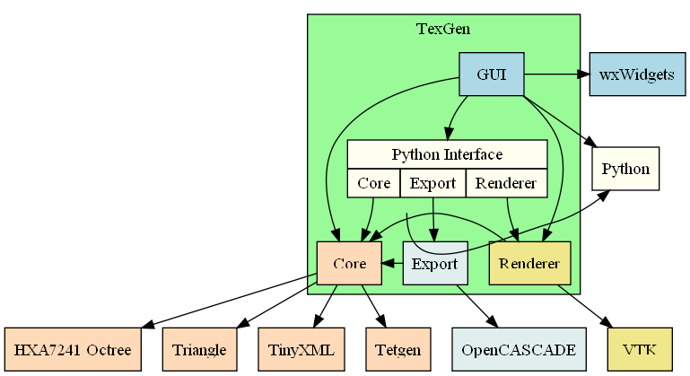
Implementation
Modular -Core functionality is in the core module, graphics are in a renderer module; if not using visualisation, the renderer doesn’t need to be built.
Flexible – Can be used with the GUI, using SWIG generated Python code or used as a library of C++ functions
Platform independent – Can be run on most operating systems supported by the Cmake build system.

Slide 4
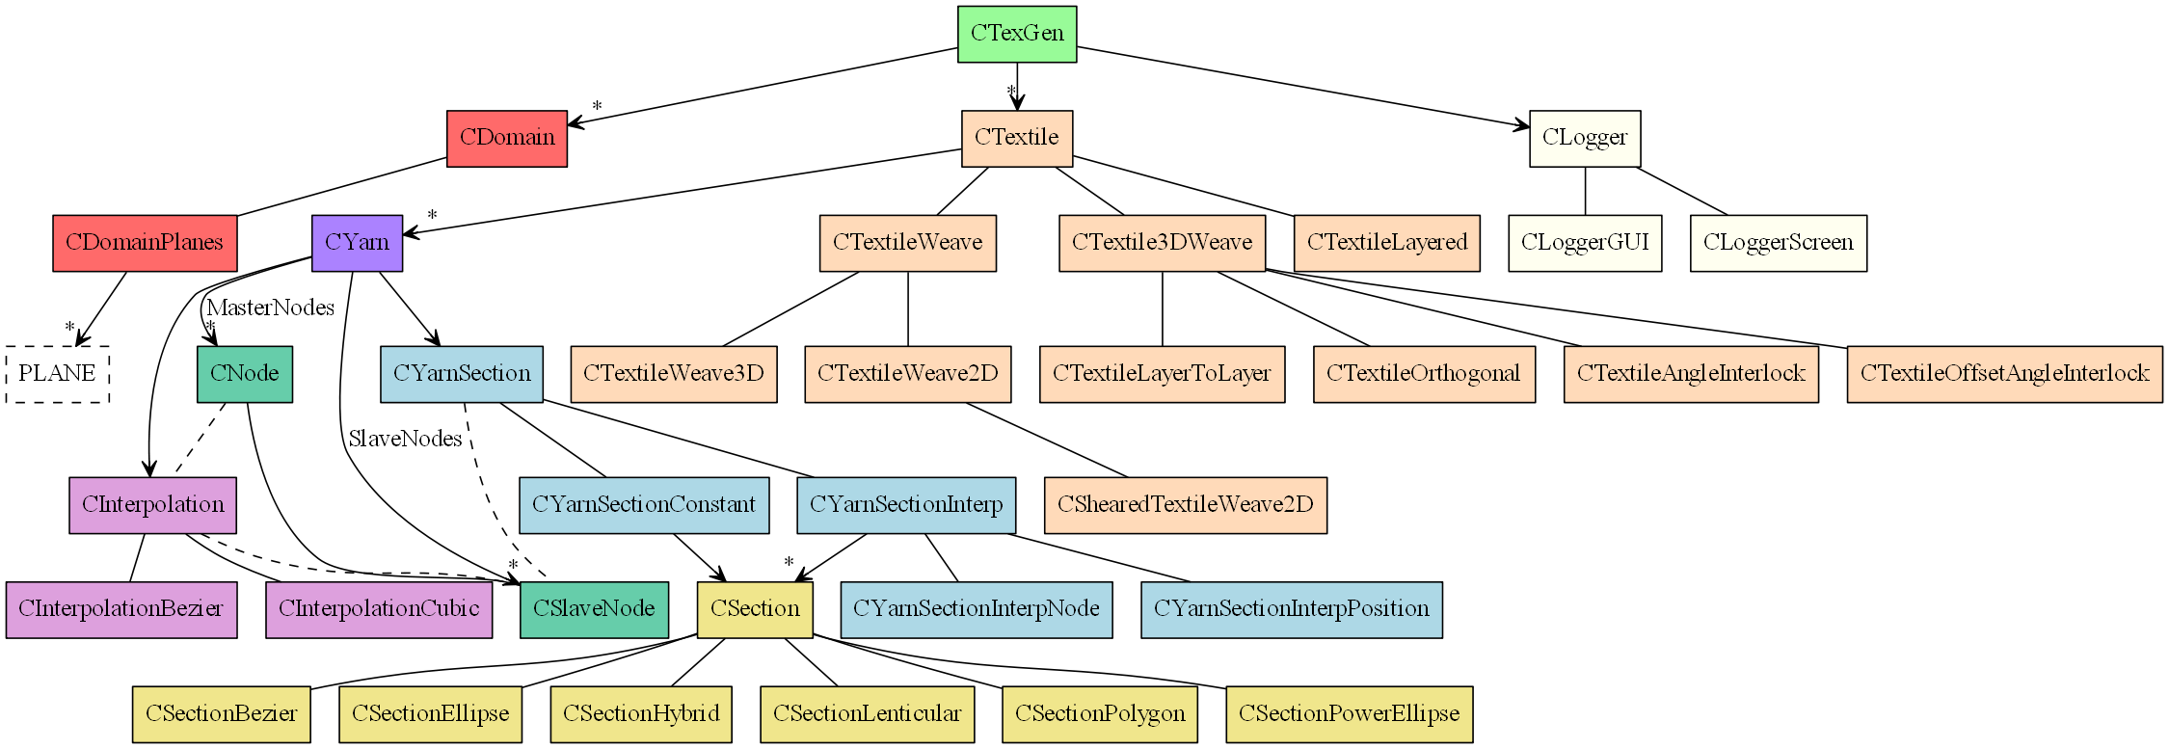
TexGen Class Heirarchy

Slide 5
Generating a Textile
1 - Create Textile
Steps combined and performed automatically in 2D and 3D wizards
Create yarn path
Assign sections
Select interpolation
Assign repeats
Assign fibre properties
2 - Add yarns
3 - Specify domain
Each step individually using either GUI, Python script or C++ API functions
4 - Output data

Slide 6
Create Textile
Each textile is created in a Ctextile object
GUI: Select Textiles -> Create Empty ( Step 1 )
Python:
Textile = CTextile()

Slide 7
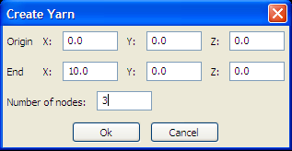
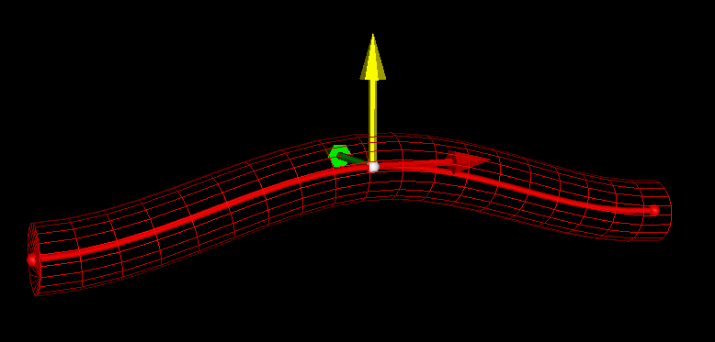
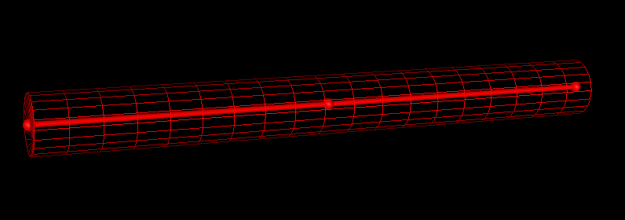
Create Yarns
Yarns are denotes by a set of Master Nodes
GUI: Select Modeller->Create Yarn ( Step 2 )
Python:
Yarn = CYarn()
Yarn.AddNode(CNode(XYZ(0,0,0)))
Yarn.AddNode(CNode(XYZ(5,0,1)))
Yarn.AddNode(CNode(XYZ(10,0,0)))

Slide 8
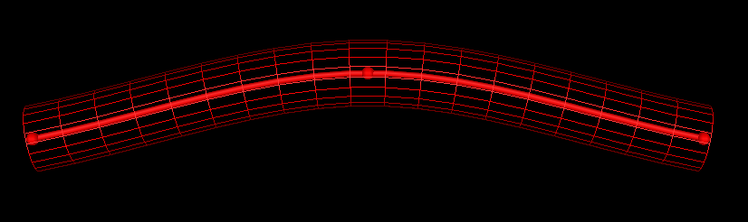
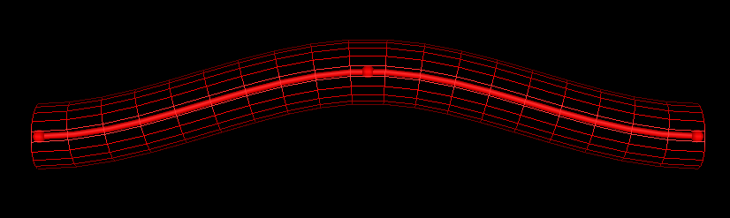
Interpolation Between Nodes
A path is generated between the master nodes by an interpolation function
GUI: Select Modeller -> Interpolation
Bezier spline
Natural cubic spline
Linear spline
Periodic – select to maintain continuity across yarn repeats
Python:
Yarn.AssignInterpolation(CInterpolationCubic())
Defaults to periodic, send False as parameter to CInterpolationCubic() for non-periodic interpolation

Slide 9
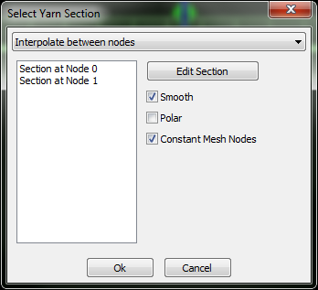
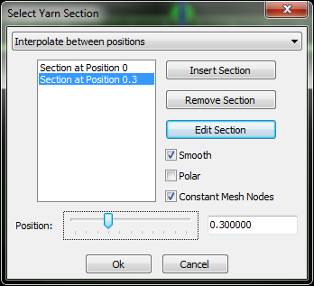
Yarn Cross-Sections - Interpolation
Yarn cross-sections are specified as 2D sections perpendicular to the yarn tangent
By default the cross-section is constant along the length of the yarn or an interpolation method can be chosen
GUI: Select Modeller -> Assign Section
Select interpolation
Constant
Interpolate between nodes
Interpolate between positions

Slide 10
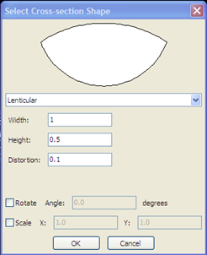
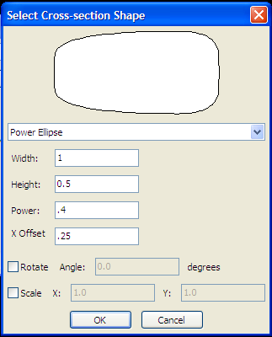
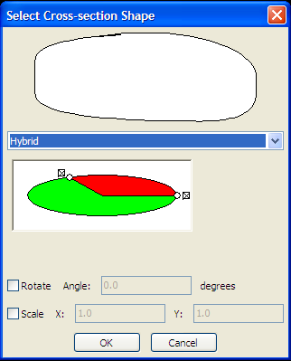
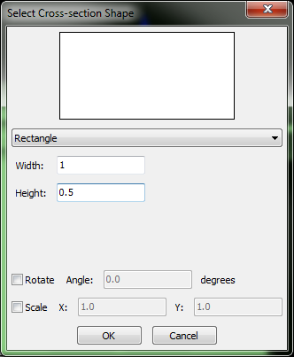
Yarn Cross-Sections – Section Specification
Cross-sections are specified at the locations given by the section interpolation
Available cross-sections:
Ellipse
Lenticular
Power ellipse
Hybrid
Rectangle
Use rather than power ellipse with power = 0 to generate uniform section meshes
Polygon
Only by scripting

Slide 11
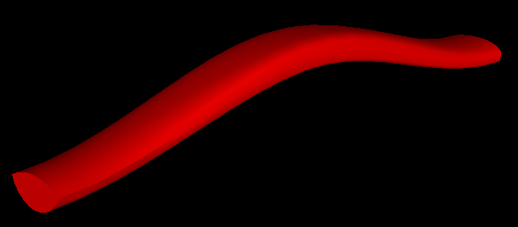
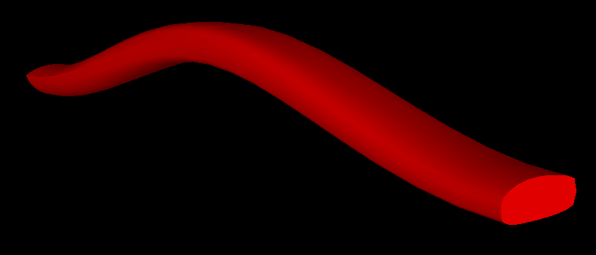
Yarn Cross-Sections – Python Implementation
Python:
YarnSections = CYarnSectionInterpNode()
YarnSections.AddSection( CSectionLenticular(1.0,0.5,0.1) )
YarnSections.AddSection( CSectionPowerEllipse(1.0,0.5,0.4,0.25) )
# Hybrid Section
Top = CSectionEllipse( 1.0, 0.4 )
Bottom = CSectionPowerEllipse( 1.0, 0.4, 0.4, 0.25 )
YarnSections.AddSection( CSectionHybrid( Top, Bottom ) )
Yarn.AssignSection( YarnSections )

Slide 12
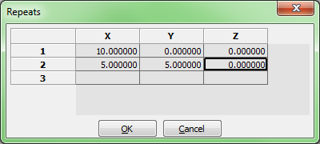
Yarn Repeats
Yarn repeats allow a given yarn section to be repeated as specified by a set of vectors (in theory, allowing an infinite textile)
GUI: Select Modeller -> Assign Repeats
Specify a set of repeat vectors
Python:
Yarn.AddRepeat(XYZ(10,0,0))
Yarn.AddRepeat(XYZ(5,5,0))
Textile.AddYarn(Yarn)

Slide 13
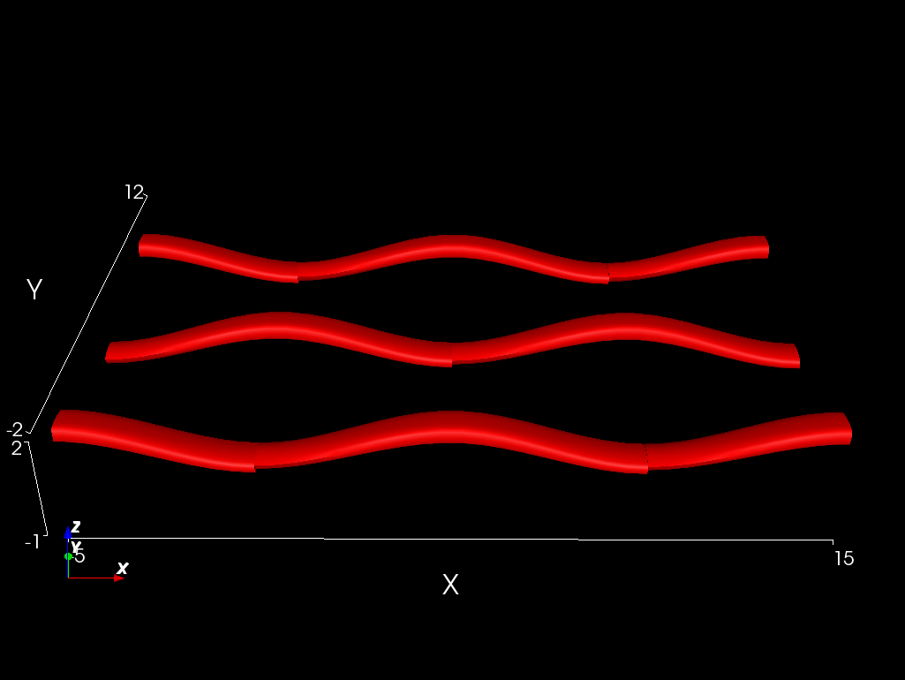
Domain
The domain restricts the model to a specific region
Specified by a set of convex planes
Typically, but not always, the unit cell
GUI:
Select Domain -> Create Box
Input minimum and maximum x,y,z values for bounding box
Or
Select Domain -> Create Planes
Input required number of planes specified by the unit normal to the plane and its distance from the origin
Python:
Textile.AssignDomain(CDomainPlanes(XYZ(-5,-2,-1),XYZ(15,12,2)))
AddTextile(“Workshop”, Textile)

Slide 14
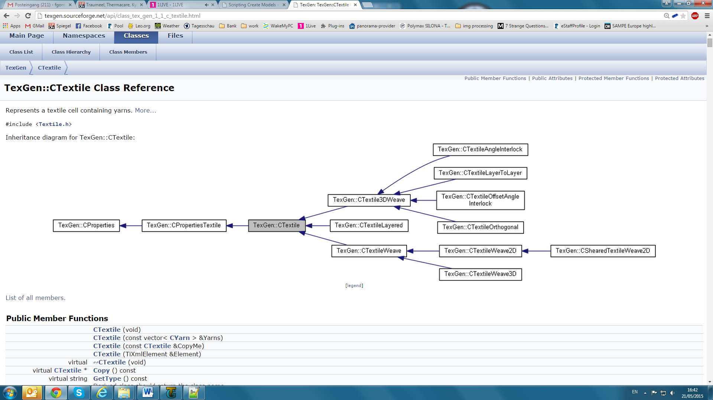
Automatically Generated Textiles
Predefined weave patterns are generated using classes which use Ctextile as a base class. They are used to input weave pattern information which then automatically generate the yarns.

Slide 15
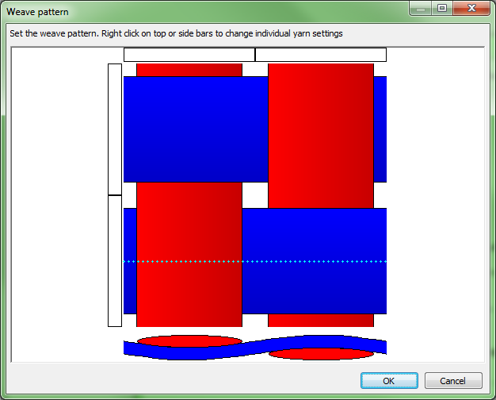
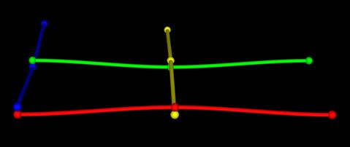
CTextileWeave2D
The 2D wizard in the TexGen GUI creates weaves using the CTextileWeave2D class
Whether the warp and weft are up or down is stored for each x,y position
Weft 0
Weft 1
0 , 1
1 , 1
Warp 1
0 , 0
Warp 0
1 , 0
GUI: Set using Weave Pattern dialog
x, y position
Python:
Values stored: 0, 1
(Weft down, warp up)
weave = CTextileWeave2D( numWefts,… numWarps,spacing, thickness )
weave.SwapPosition(0, 0)
weave.SwapPosition(1, 1)

Slide 16
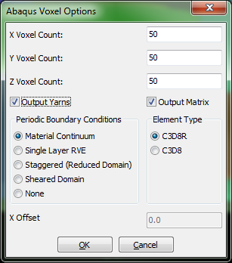
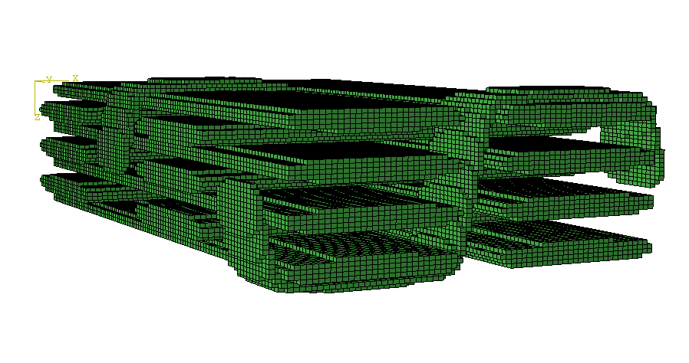
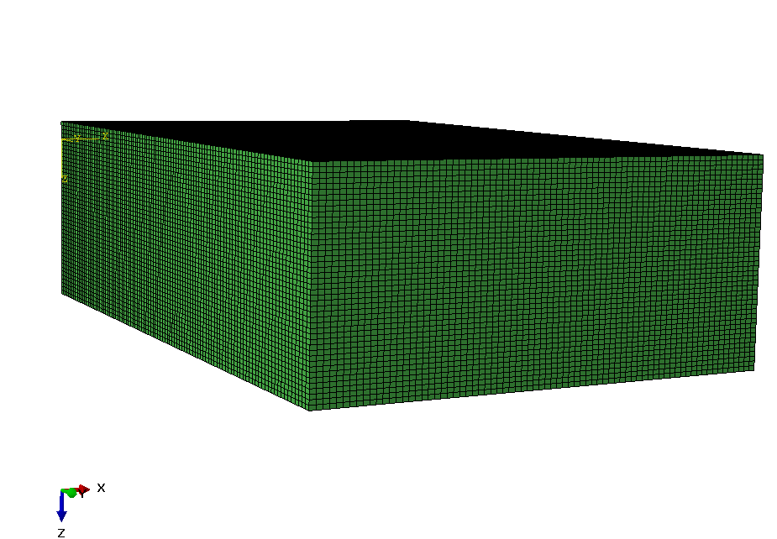
ABAQUS Voxel Export
GUI: Select File -> Export -> ABAQUS File -> ABAQUS Voxel File
Hex elements
Periodic boundary conditions and steps for extraction of material properties
http://texgen.sourceforge.net/index.php/Extraction_of_Material_Properties_using_Voxel_Meshing_and_Abaqus
All ABAQUS exports include additional .ori and .eld files containing element orientation, fibre volume fraction and yarn information.

Slide 17
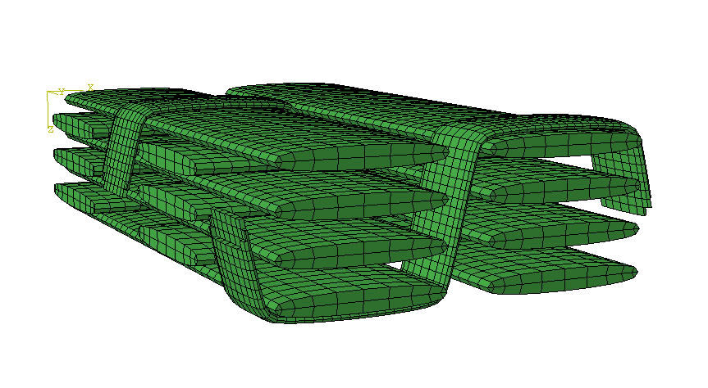
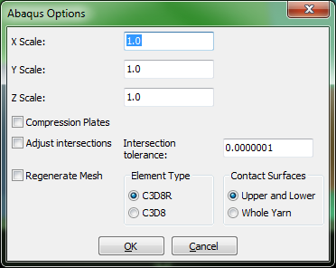
ABAQUS Dry Fibre Export
GUI: Select File -> Export -> ABAQUS File -> ABAQUS Dry FibreFile
Conformal mesh using hex and wedge elements
Uses weave pattern information to generate contact surfaces
Correction for small intersections

Slide 18
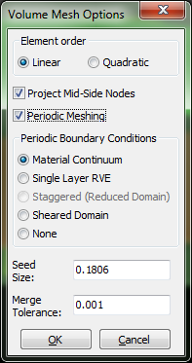
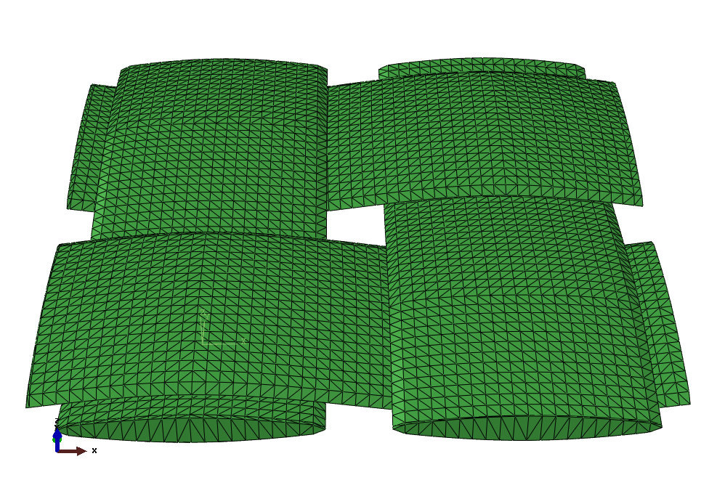
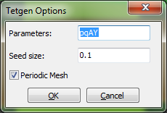
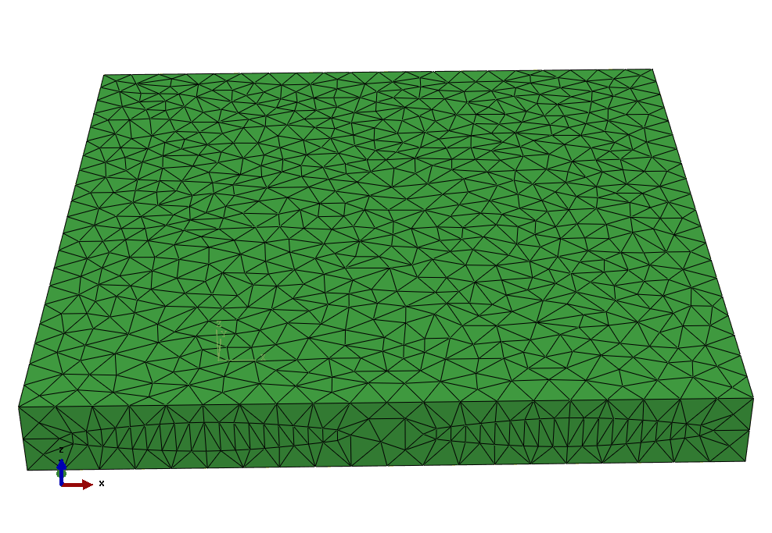
Conformal Mesh
Volume Mesh
GUI: Select File -> Export -> Volume Mesh
Tetrahedral elements
Save as ABAQUS .inp file or .vtu
Works best for 2D weaves
Tetgen Export
GUI: Select File -> Export -> Tetgen Mesh
Tetrahedral elements
Save as ABAQUS .inp file
May need to introduce gap between yarns for export to be successful
Uses Tetgen library: http://wias-berlin.de/software/index.jsp?id=TetGen&lang=1

Slide 19
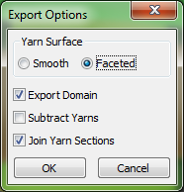
Geometry Export
The geometry alone can be exported in IGES, STEP or stl format. No orientations, volume fractions or properties are exported.
GUI: Select File -> Export -> IGES File
or -> STEP File
This option uses the OpenCASCADE library.
The ‘Smooth’ option may be unsuccessful for more complex geometries
‘Join Yarn Sections’ will remove joins at repeat boundaries but is much slower
GUI: Select File -> Export -> Surface Mesh
Exports the surface mesh as displayed by Rendering -> X-Ray
Saves in .vtu or .stl format

Slide 20
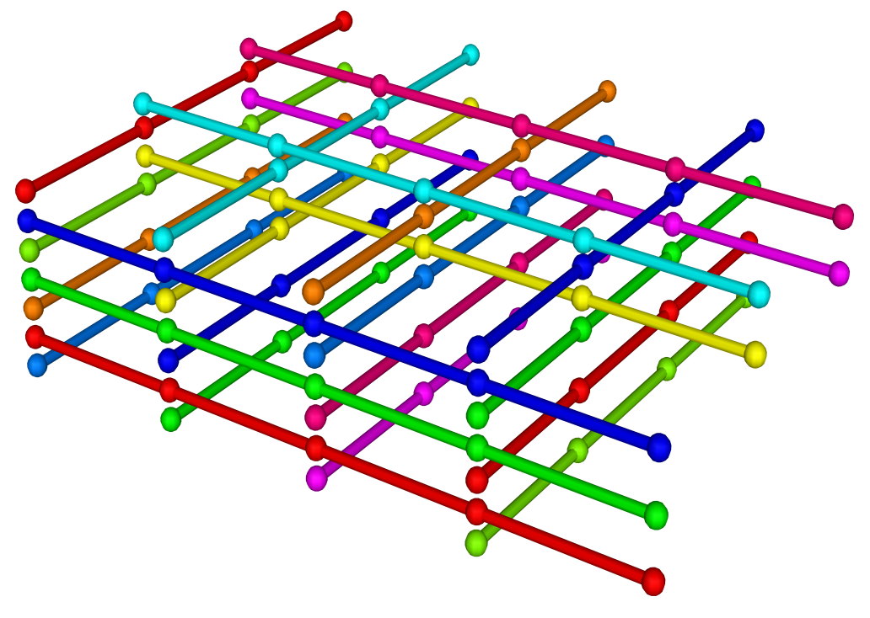
Automatically Generated 3D Weaves
These all use the CTextile3DWeave base class
Creates a grid of points at the yarn crossovers, specified in the GUI by the Weave Pattern dialog
Each point may be warp, weft or no yarn
The derived classes then automatically generate the yarn paths from this dat
Textiles using the base class can be created using a Python script
2
1
0
i_{x}
i_{y}
1
2
0
3
8
6
i_{z}
4
2
0
Layers (z)
Weft (y)
Warp (x)

Slide 21
Resources
User Guide: http://texgen.sourceforge.net/index.php/User_Guide
Scripting Guide:
https://github.com/louisepb/TexGenScriptingGuide
TexGen source code:
https://github.com/louisepb/TexGen
Workshop materials:
https://github.com/louisepb/ICMAC2018-Workshop

